Slide 1


Operation Analytics and Investigating Metric Spike

Slide 2

PROJECT
DESCRIPTION
This project analyzes job data and investigates metric spikes to improve a company's operations. I have uncovered valuable insights using SQL queries, such as user engagement, retention rates, and workflow optimizations. These data-driven findings will guide better decision-making and enhance overall performance.

Slide 3

APPROACH
Data Understanding:
I carefully reviewed the data sets, grasping table structures, and column meanings.
SQL Analysis:
Utilizing SQL queries, I extracted valuable information and insights from the data.
Case Study 1:
Calculated metrics like jobs reviewed per hour, 7-day rolling average of throughput, and language percentage share.
Case Study 2:
Analyzed user data to derive metrics such as weekly engagement, growth, and email engagement.
Data Visualization:
Presented findings using charts and graphs for clear and easy understanding.

Slide 4



TECH-STACK
USED
I have mainly used 3 tools:-
MS Excel (Microsoft 365)
I used it for visualization purposes.
MySQL Workbench 8.0.33
I used it for analyzing the dataset provided.
PowerPoint (Microsoft 365)
I used it for the presentation.

Slide 5

INSIGHTS
Case Study 1: Job Data Analysis
Jobs reviewed overtime
Throughput analysis
Language share analysis
Duplicate rows detection

Slide 6

INSIGHTS
Case Study 2: Investigating Metric Spike
Weekly User Engagement
User Growth Analysis
Weekly Retention Analysis
Weekly Engagement Per Device
Email Engagement Analysis

Slide 7
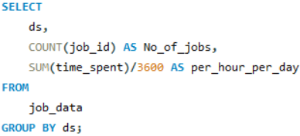
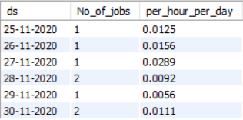
INSIGHTS
Case Study 1: Job Data Analysis
A. Jobs reviewed overtime
The data shows the number of jobs reviewed per day and the time taken to review the jobs per hour for each day. It shows that on 27th November 2020 one job took maximum time to review.

Slide 8

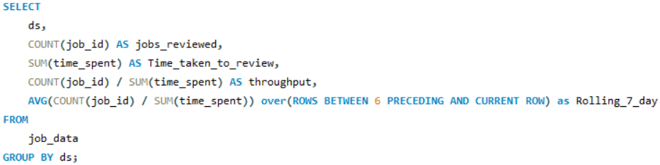
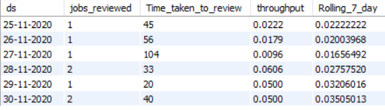
INSIGHTS
Case Study 1: Job Data Analysis
B. Throughput Analysis
The data shows the throughput and 7-day rolling average of the throughput. I would prefer 7-day rolling average of throughput rather than daily metric because it provides a more stable trend over time, indicating the overall efficiency of the job review process.

Slide 9
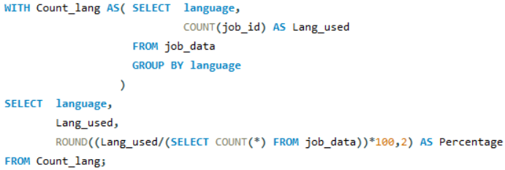
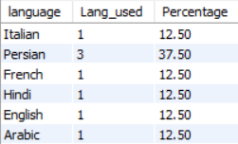
INSIGHTS
Case Study 1: Job Data Analysis
C. Language share analysis
With this query, I identified that Persian was the most used language within the last 30 days. It holds 37.5% of the total share among all the languages.
Persian

Slide 10

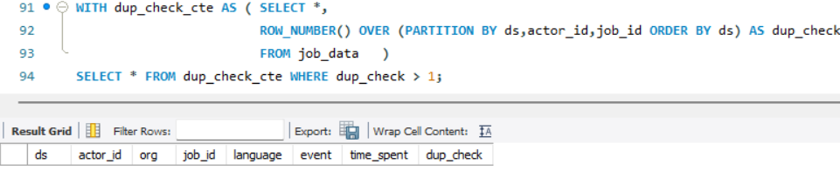
INSIGHTS
Case Study 1: Job Data Analysis
D. Duplicate rows detection
From the below query I identified that there is no duplicate rows in job_data table.

Slide 11
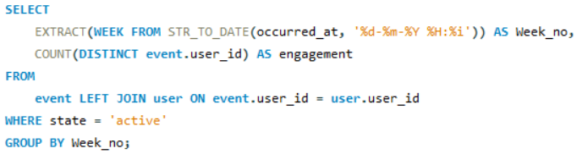
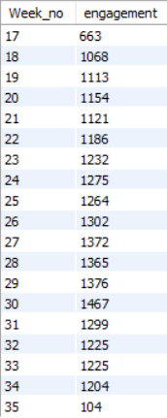
INSIGHTS
Case Study 2:
Investigating Metric Spike
A. Weekly user engagement
The information that I got from the data using this query is that the engagement was constant but there was a sudden dip in engagement in week 35.

Slide 12
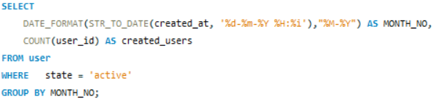
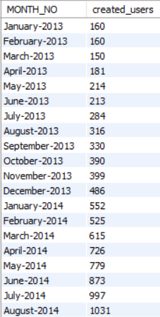
INSIGHTS
Case Study 2:
Investigating Metric Spike
B. User growth analysis
In January 2013, the product witnessed a sign-up of 160 users. Over time, the number of monthly sign-ups steadily increased, reaching its peak in August 2014 with a record 1031 users registering for the product.
Aug-14

Slide 13

INSIGHTS
Case Study 2:
Investigating Metric Spike
C. Weekly retention Analysis
The given output indicates that a significant number of users (3743) were retained within the first week of signing up for the product. However, retention gradually declines over time, emphasizing the importance of early user engagement and onboarding. To improve long-term retention, the product team should focus on enhancing the user experience, implementing feature updates, and employing targeted marketing strategies beyond the critical first few weeks.

Slide 14
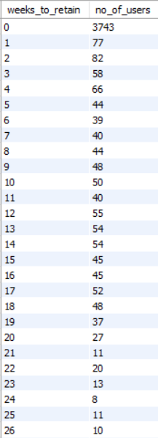
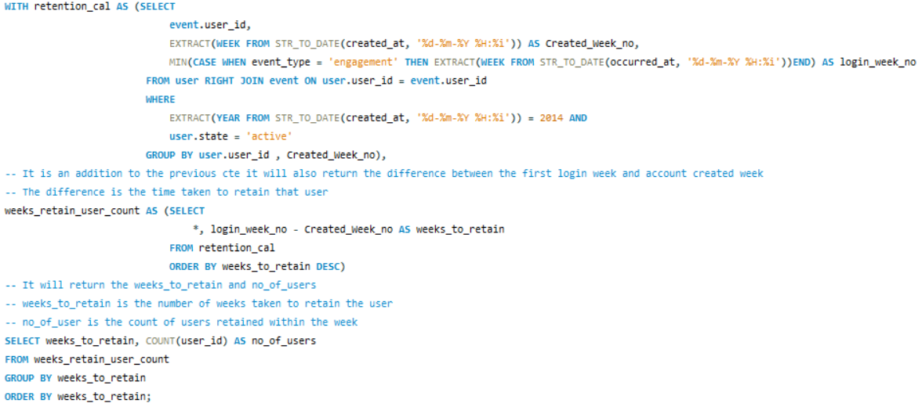

INSIGHTS
Case Study 2:
Investigating Metric Spike

Slide 15
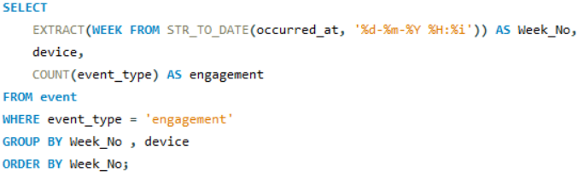
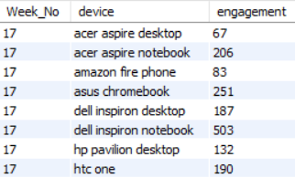

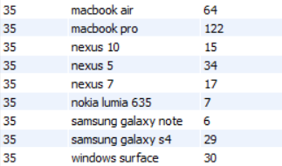
INSIGHTS
Case Study 2:
Investigating Metric Spike
D. Weekly engagement per device
This SQL query helped me to find how much engagement of users was there every week on each device.
.
.
.
.
.
.
.
.
.
.
.
.
491 rows

Slide 16
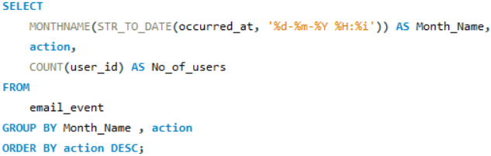
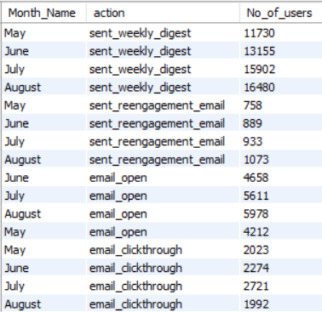
INSIGHTS
Case Study 2:
Investigating Metric Spike
E. Email engagement analysis
The company is sending more emails each week, but they are not seeing a corresponding increase in click-throughs. This suggests that they need to improve the content of their emails or the way they are targeting their audience.
Sent_weekly_digest
email_open
email_clickthrough
sent_reengagement_email

